Slide 1
ENVIRONMENTAL & SOCIAL Risk Management
CIU Safeguards Team

Slide 2

Purpose of Orientation
To familiarize WB Project workers with the environmental and social (E&S) risk management requirements and procedures of the World Bank
To explain the role of the CIU E&S (Safeguard) Team
To familiarize Project Workers with Grievance and Incident Management procedures
To consider key elements of Marshallese culture
To review the Code of Conduct for WB Project Workers in RMI prior to signing.

Slide 3



WORLD BANK PROJECTS IN RMI
Government
World Bank provides $$ for a specific purpose as requested by RMI government
Implementing Agency
World Bank
Beneficiaries & Suppliers
Centralized Implementation Unit (CIU)
CIU provides support with
Project Implementation Unit (PIU)
PIU Project Management
PIU contracts and procures goods and services
Safeguards*
Financial Management
Procurement
* Environmental and Social (E&S) Risk Management associated with projects, including workplace risks

Slide 4

Majuro: Kimber Rilometo
Safeguards Officer (DIDA)
Office Phone: (692) 625 5968
Email: ciu.safeguards1@gmail.com
Ebeye: Yumi Crisostomo
CIU Ebeye Program Officer
Email: mikefamilystore@gmail.com
Remote: Colleen Peacock
(Fiji) Social Safeguards Specialist
Email: colleen@tautai.com
Remote: Garry Venus
(NZ) Environmental Safeguards Specialist
Email: gazza700@gmail.com
CIU SAFEGUARDS TEAM

Slide 5
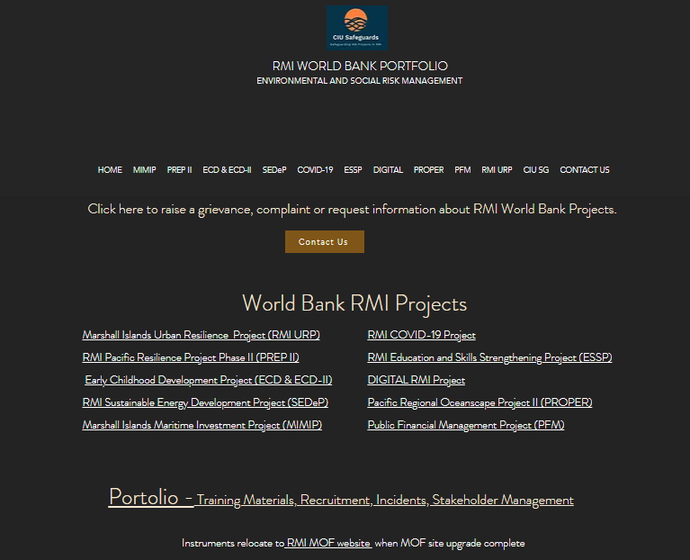
https://www.ciudidasafeguards.com

Slide 6



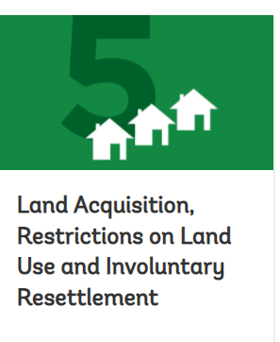
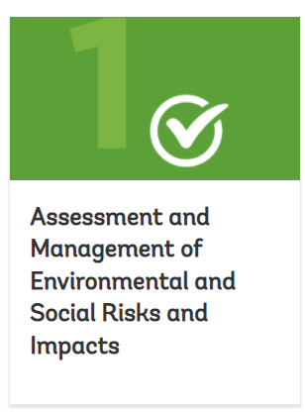
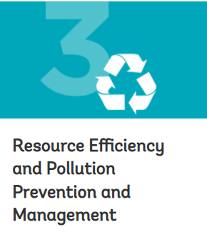



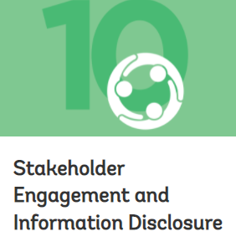

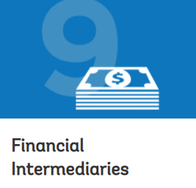
ENVIRONMENT & SOCIAL STANDARDS (ESS)
COUPLE KEY

Slide 7
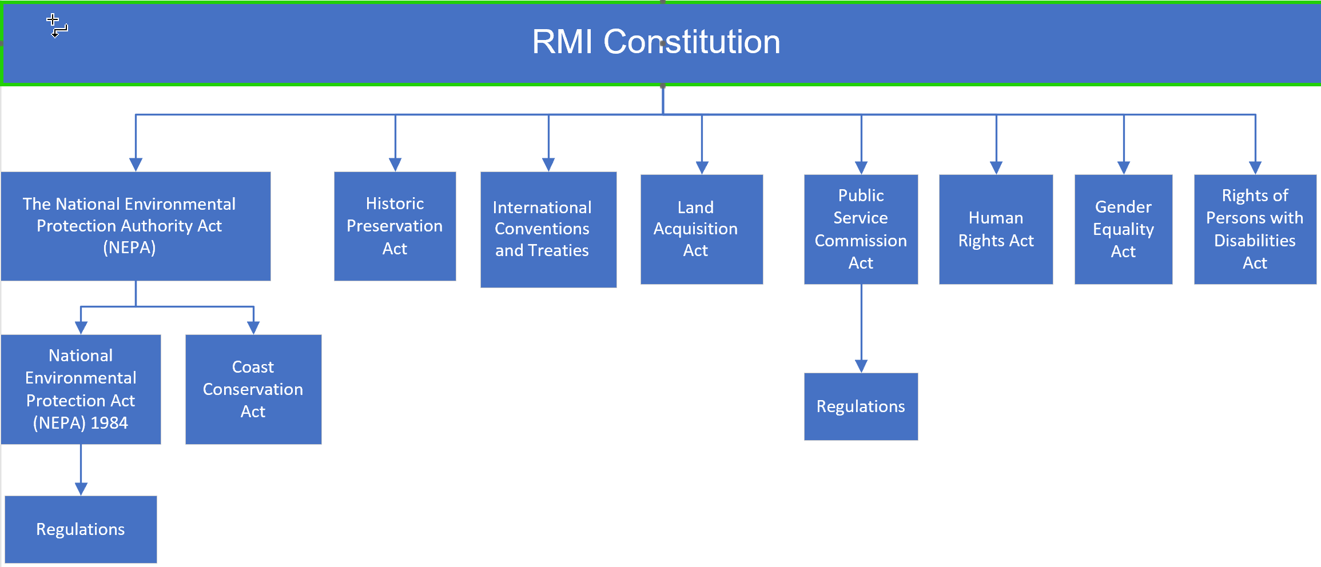

ESMF/ESMP MUST BE CONSISTENT WITH RMI LAW & REGS

Slide 8

WORLD BANK ENVIRONMENTAL AND SOCIAL FRAMEWORK
MIMIP, PREP II, PFM and SEDeP were prepared under “old” safeguards procedures
All other recent projects were developed under the 2017 Environmental and Social Framework (ESF), including:
    Digital RMI
    Education and Skills Project
    ECD Phase II
    PROPER
    RMI-URP
    COVID-19
    RMI-WB ESF instruments include:
    Environmental and Social Management Framework (ESMF) or an ESMP
    Stakeholder Engagement Plan (SEP)
    Grievance Redress Mechanism (GRM),
    Labour Management Procedures (LMP)
    Environmental and Social Commitment Plan (ESCP)

Slide 9
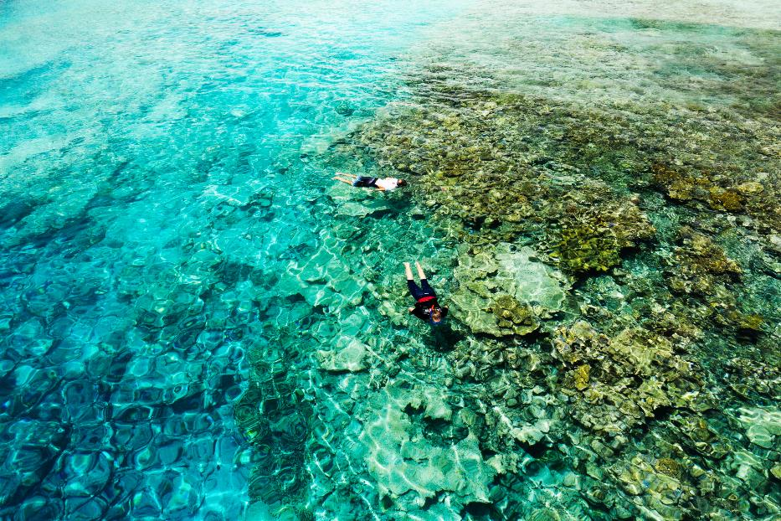
ENVIRONMENTAL & SOCIAL MANAGEMENT FRAMEWORK (ESMF) or PLAN (ESMP)
ESMF is prepared when project risks and impacts cannot be determined until the project or sub-project details are identified.
ESMP is prepared when risks and impacts can be determined.
ESMF/ESMPs set out standards and procedures that will be used to reduce, mitigate and/or offset adverse risks and impacts. It includes the budget to implement these measures and identifies the agencies responsible for addressing project risks and impacts.

Slide 10
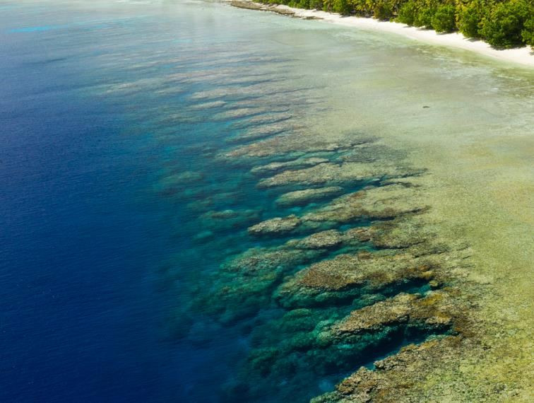
CONTRACTOR ENVIRONMENTAL AND SOCIAL MANAGEMENT PLAN C-ESMP
Manages E&S, Security, Health and Safety risks related to the construction activities.
To be prepared by Contractors and cleared by CIU (and WB as agreed)
Detail depends on the Project ESMP, LMP, SEP and Project Contract.
Specific to the risks that relate to the activities under the control of the Contractor.
Proportionate to Project risks.

Slide 11
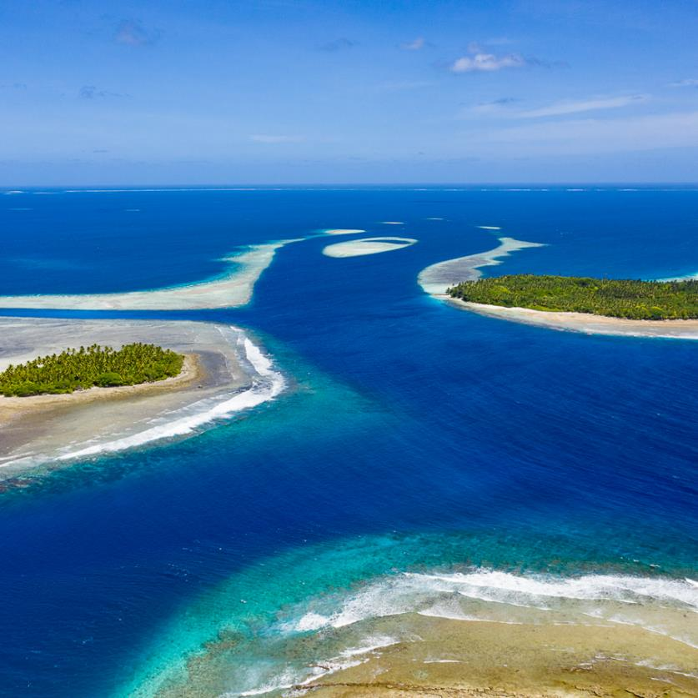
ENVIRONMENTAL AND SOCIAL COMMITMENT PLAN (ESCP)
  Is a legal agreement between GoRMI and the World Bank and forms part of the Project Finance Agreement
  Includes time-bound actions that must be monitored and reported on as per the agreement
  Purpose is to ensure protection of the environment, people’s health, safety and human rights

Slide 12
LABOR MANAGMENT PROCEDURES (LMP)
New requirement under ESF
Labor management procedures set out the way in which project workers will be managed, in accordance with the requirements of national law and ESS2.
Matters covered
  Working conditions & management of worker relationships
  Protecting the work force
  Labor grievance mechanism
  Occupational Health and Safety (OHS)

Slide 13
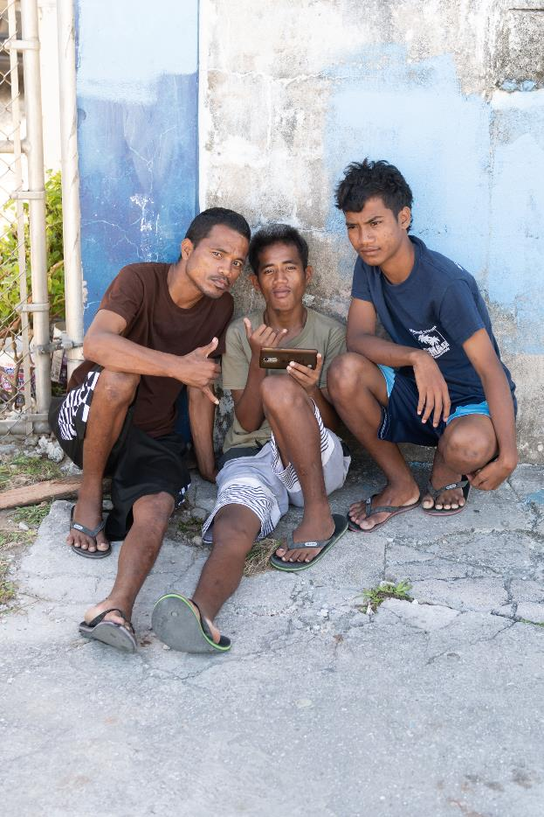
STAKEHOLDER ENGAGEMENT PLAN (SEP)
Is proportionate to the nature and scale of the project and its potential risks and impacts.
Describes timing and methods of engagement with stakeholders through the life cycle of the project.
Distinguishes between “project-affected parties” and other interested parties.
Sets out how communication with stakeholders will be handled throughout project preparation and implementation.
Provides the basis for developing annual or activity specific Stakeholder Engagement and Communication Action Plans (SECAPs).
Explains how the grievance mechanism will operate to resolve any concern or grievance related to the Project.

Slide 14
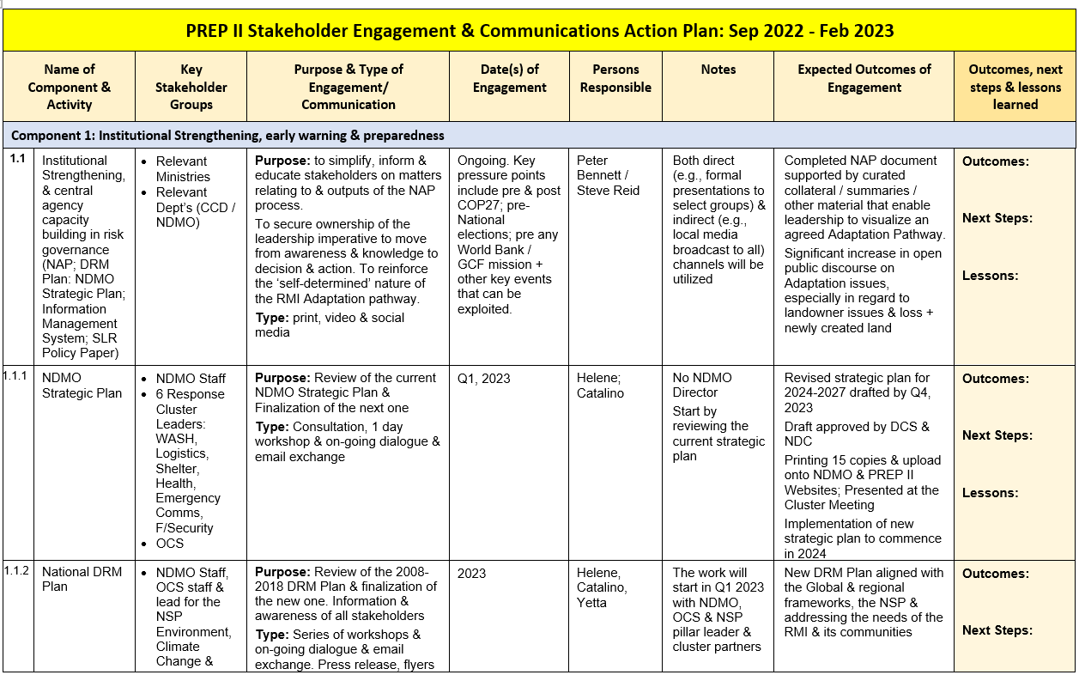

Slide 15
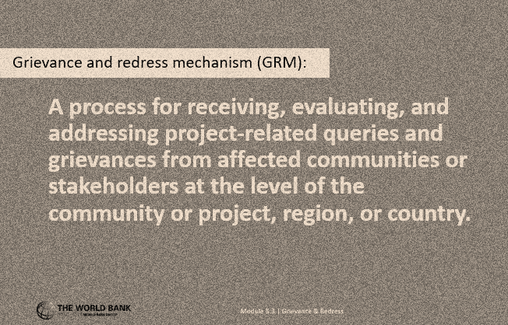
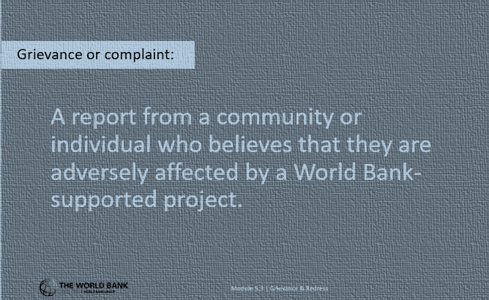
PROJECT GRM
The GRM can be used by an individual or by a group of people who have a concern or complaint about any aspect of the Project including social, cultural, environmental, land, livelihoods, health, safety, factors.

Slide 16
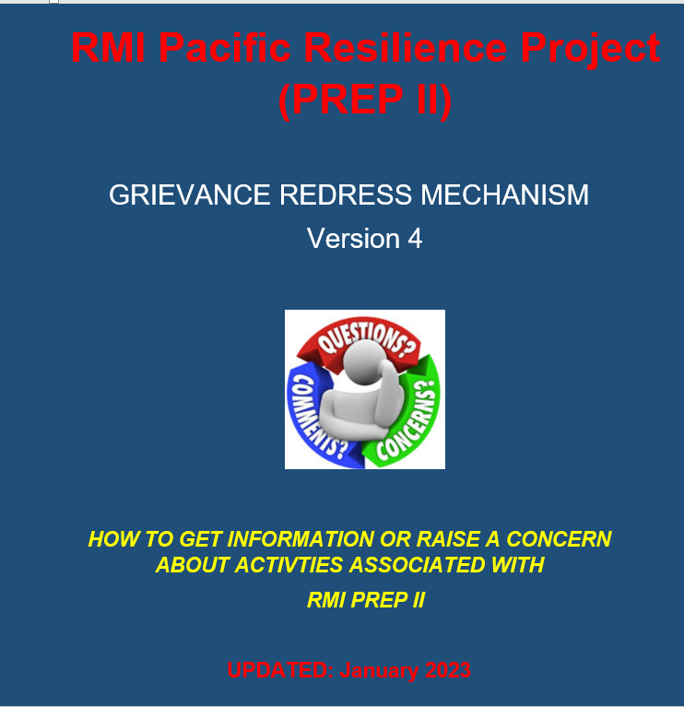
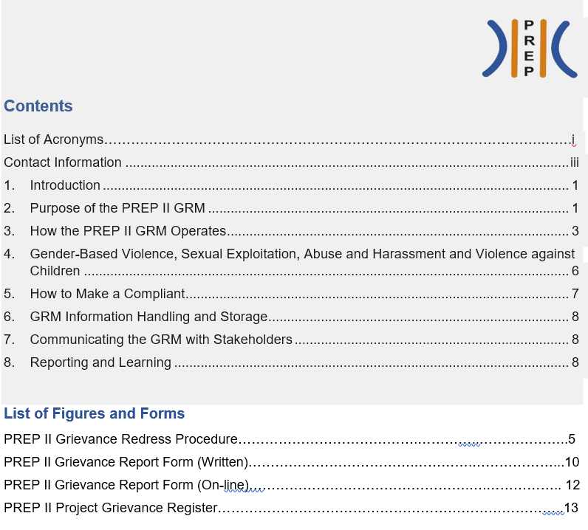
Project GRMs

Slide 17
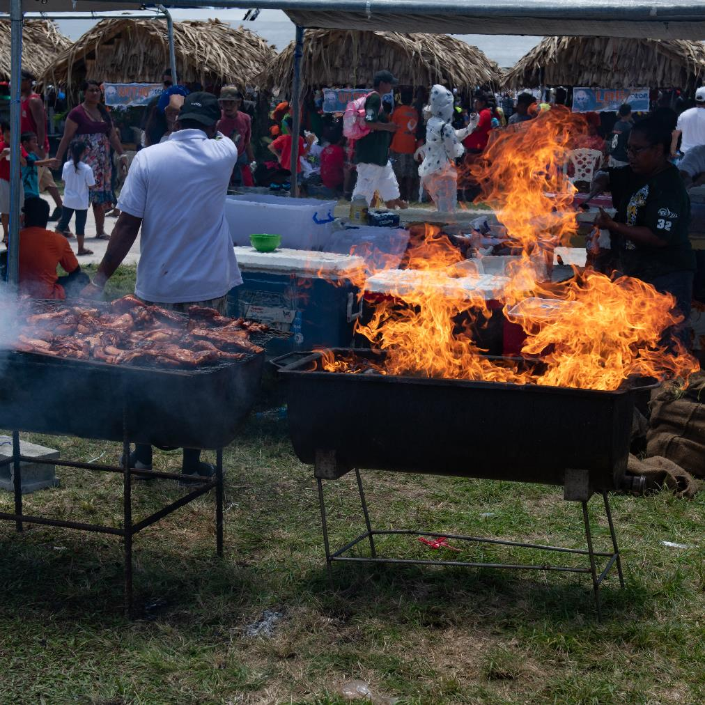
GRMs: Key Points
Grievances can be raised in open and public manner, or anonymously and in confidence; the identity of complainants is kept confidential.
Different issues require different responses, including “serious or sensitive” matters.
The intent of the GRM is to solve problems as quickly and as fairly
GRMs are implemented in accord with existing systems and processes where appropriate
The GRM is not a substitute for legal proceedings and does not remove people’s right to take their grievance to a formal dispute-resolution mechanism.
The GRM only deals with Project-related matters; other issues are referred to the appropriate authority.

Slide 18
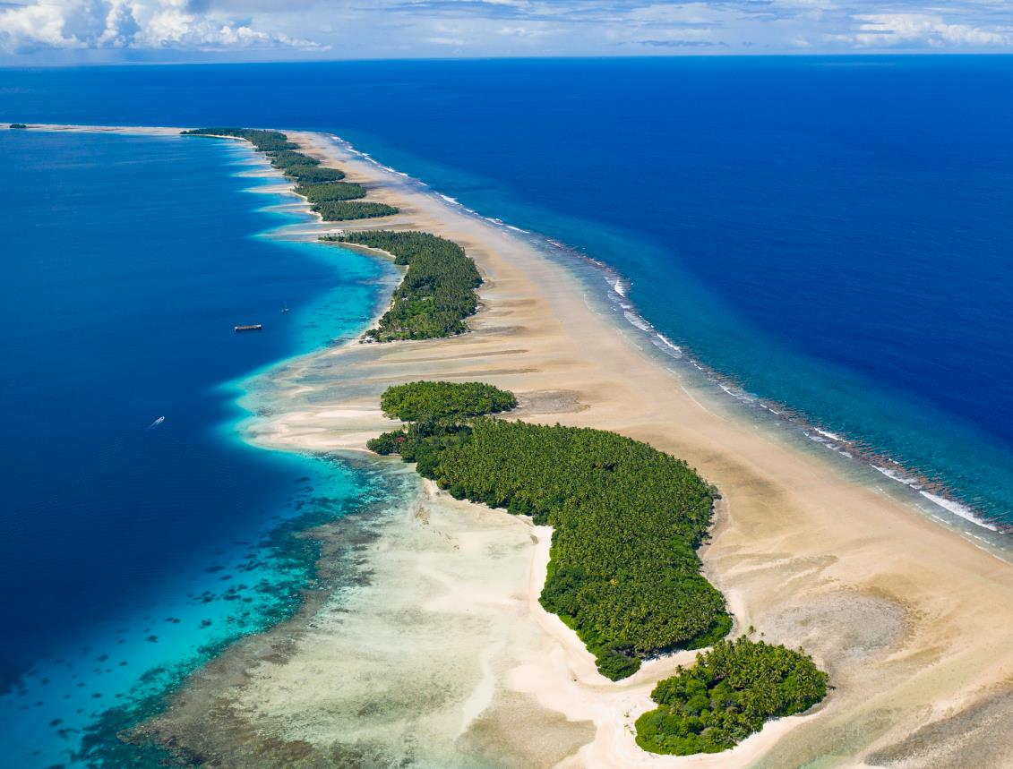
How PROJECT GRMs Operate
The person in charge of making sure the Project GRM operates effectively is the “Designated Contact Person” (DCP). The Project Manager is usually the DCP.
The DCP stays involved until the matter is resolved and is the main point of contact. During project works, the Construction Site Supervisor (CSS) can serve as the DCP until the matter is resolved or transferred to the Project Manager.
All aspects of the GRM process are fully documented using set forms and processes. A high degree of confidentially must be maintained.

Slide 19
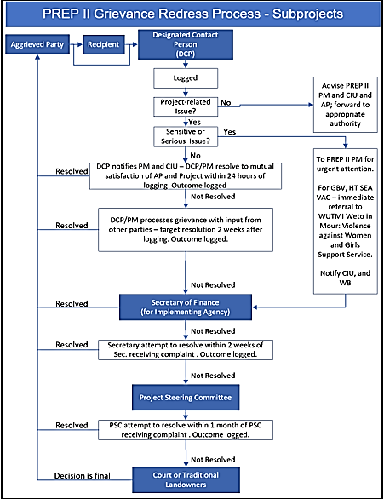
PROJECT GRM
Step-by-Step Process
Step 1: “Aggrieved Party” (AP) raises a concern with the “Recipient”. The Recipient is required to pass the information to the DCP or the CSS within 12 hours of receipt, using the Project Grievance Form.
Step 2: After receiving the compliant, the DCP documents the concern in the Project Complaints Register.
Step 3: The DCP determines if the concern is related to the Project, and if it is, an investigation begins immediately. If the matter is not related to the Project, the AP is referred to the appropriate authority to resolve the issue and the matter is closed on the Complaints Registry.
Step 4: The DCP determines if the complaint relates to a serious or sensitive matter. If it does, the DCP immediately refers the matter to the General Manager (GM) of the IA for further investigation and resolution. The DCP also notifies DIDA and the World Bank.

Slide 20
Dealing with serious and sensitive situations
“Serious or sensitive matters” refer to issues involving potential criminal activity, political interference, conflicts of interest, corruption, land claims, gender-based violence, and human trafficking.
In the case of potential criminal activity, it is important that the Project GRM process does not impede investigation by the appropriate authorities. In situations involving land disputes or claims, the matter will be referred to the Traditional Court.
If the concern is related to GBV, SEAH, or VAC, the Project will first seek to ensure that the victim is safe and has access to support services. A referral can also be made to the WUTMI Weto in Mour: Violence against Women and Girls Support Service and/or other authorities.
WB Projects in RMI use a survivor-centered approach.
This means that the rights, needs, and wishes of the survivor (or victim) is the foremost priority of everyone involved with the project
The survivor has a right to:
  Be treated with dignity and respect instead of being exposed to victim-blaming attitudes.
  Choose the course of action in dealing with the violence instead of feeling powerless.
  Privacy and confidentiality instead of exposure.
  Non-discrimination based on gender, age, race/ ethnicity, ability, sexual orientation, HIV status or any other characteristic.
  Receive comprehensive information to help her make her own decision instead of being told what to do.

Slide 21
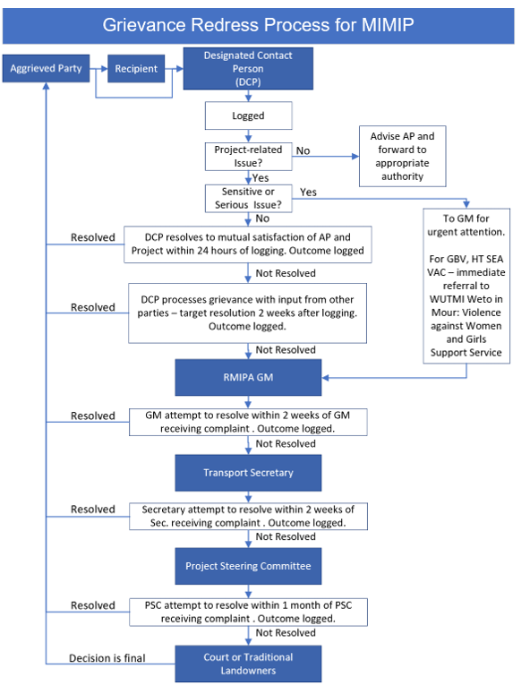
PROJECT GRM
Step 4: After determining the grievance is Project-related but not serious of sensitive nature, DCP attempt to resolve concern to everyone’s satisfaction within 24 hrs, or within 2 weeks if consultation with other parties is required. If resolution cannot be achieved, DCP refer the matter to the GM of IA for further investigation.
Steps 5-6: The GM of the IA attempts to resolve concern within 2 weeks and if this is not achieved, the situation will be referred to the Secretary, of the IA, who will also attempt to resolve the matter within 2 weeks.
Step 7: If resolution has still not occurred following attempts by the GM IA and Secretary, the Project Steering Committee (PSC) will have 1 month to resolve the matter.
Step 8: If the issue remains unresolved or the complainant is dissatisfied with outcome proposed by PSC, the Aggrieved Person may refer matter to appropriate legal or judicial authority. The decision of the Court will be final.

Slide 22
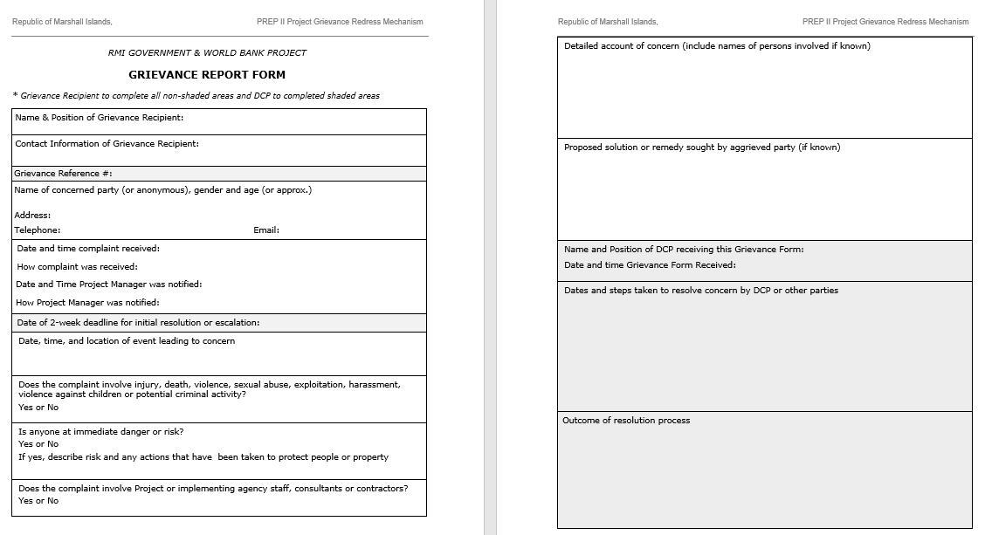
Grievance Report Form

Slide 23
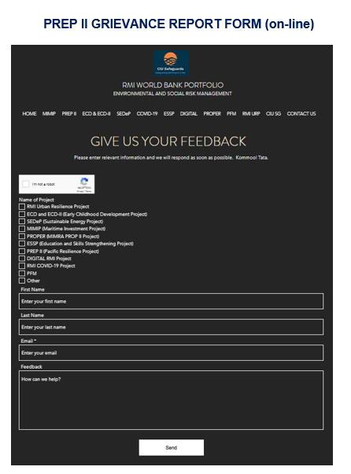
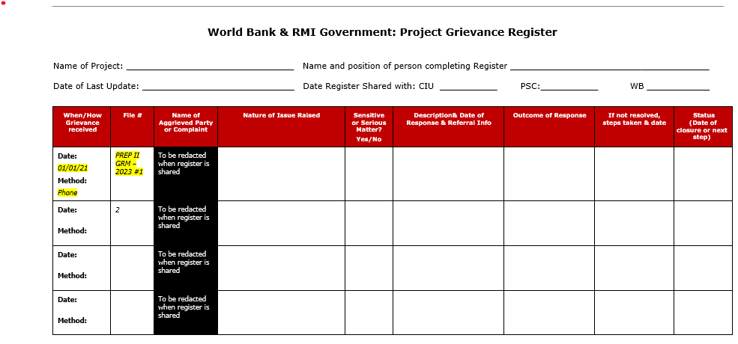

Slide 24
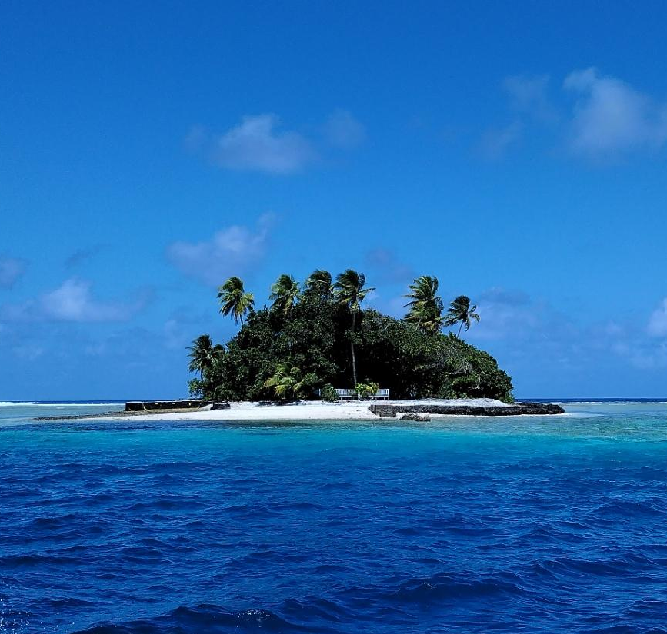
Working in RMI
MANIT - People and Environment
Manit - a tradition, a custom; culture, heritage
Armej - people (Iroj, Alab im Rijerbal - Kora, Maan im Ajri)
Nukwi - duties of a relative / to be related
Ineeṃṃan - to be serene / to be respectful
Tūriaṃo - to have mercy, to have compassion

Slide 25
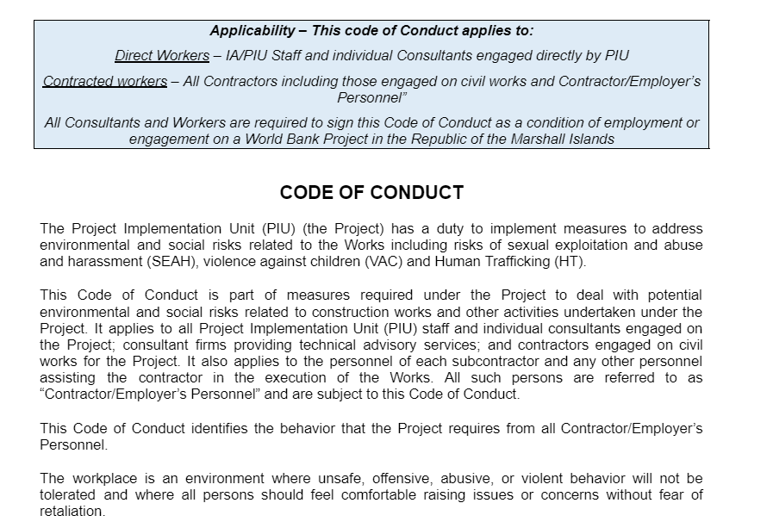

World Bank Project Worker Code of Conduct (CoC)
REQUIRED CONDUCT
I, the undersigned worker/contractor, understand that adhering to
Code of Conduct is available for download from: https://www.ciudidasafeguards.com/portfolio-documents

Slide 26

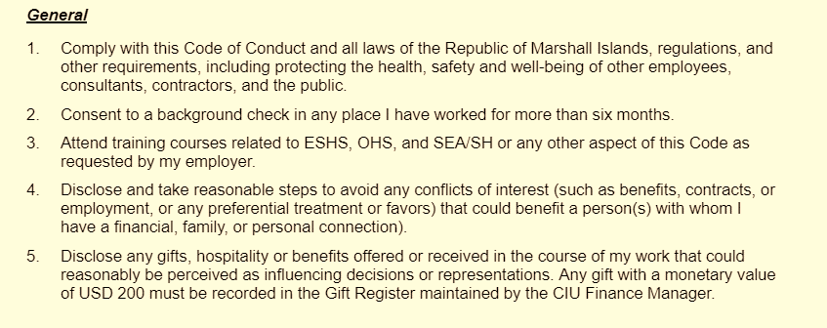
REQUIRED CONDUCT
I, the undersigned worker/contractor, understand that adhering to the following professional requirements and behavioral standards, including those related to environmental, social, health and safety (ESHS); occupational health and safety (OHS); sexual exploitation and abuse (SEA), sexual harassment (SH) and treatment of children is compulsory under my employment contract.
I agree that while working on the Project I will:

Slide 27
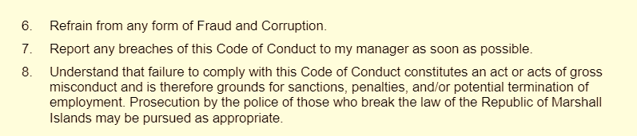
Project Worker CoC (cont.)

Slide 28
Project Worker CoC (cont.)
Professional Conduct
Carry out my duties competently, diligently and to the best of my ability.
Behave, at all times, in a way that upholds the integrity and good reputation of my employer.
Ensure the proper use of all worksite and workplace materials by not engaging in theft, carelessness, misuse and wastefulness.
Maintain confidentiality about stakeholder, employee and organizational information and data involved with my work.
Comply with any lawful and reasonable direction given by a person in the organization who has the authority to give this direction.
Not consume alcohol or use of narcotics, drugs or other substances which can impair faculties during work activities, including attending work under the influence of these substances.
Be sensitive to Marshall Islands culture and protocols in planning and implementing work.
Use specified sanitary facilities provided by the employer and not open areas.

Slide 29
Project Worker CoC (cont.)
Treatment of Others
Not discriminate against any person based on family status, ethnicity, race, gender, sexual orientation and identity, age, language, religion, marital status, political or other opinion, national origin, disability, health, or other status.
Treat all members of the community and any affected person(s) with respect.
Not perpetrate any form of physical or sexual violence on any person, including respecting their religion, culture, beliefs, and traditions.
Not use language or behavior toward any person that is inappropriate, harassing, abusive, sexually provocative, demeaning or culturally inappropriate.

Slide 30
Project Worker CoC (cont.)
Violence Against Children (VAC)
Not participate in any sexual contact or activity with children under the age of 18, except in the case of a pre-existing marriage. Mistaken belief regarding the age of a child or “consent” from the child are not an acceptable defense or excuse.
Ensure the protection and safety of children under the age of 18 by:
  Informing my manager of the presence of any children in project offices or sites who are or may be exposed to hazardous activities.
  Ensuring that another adult is present when working close to children wherever possible.
  Not inviting unaccompanied children, who are not my family, into my home.
  Not accessing child pornography.
  Refraining from physical punishment or discipline of children.
  Taking appropriate caution when photographing or filming children for work-related purposes.
Consent is defined as the informed choice underlying an individual’s free and voluntary intention, acceptance, or agreement to do something. No consent can be found when such acceptance or agreement is obtained using threats, force or other forms of coercion, abduction, fraud, deception, or misrepresentation. Consent cannot be given by a child under the age of 18, even where legislation in the RMI has a lower age.

Slide 31
Sexual Exploitation and Abuse (SEA) means any actual or attempted abuse of position of vulnerability, differential power, or trust, for sexual purposes, including, but not limited to, profiting monetarily, socially, or politically from the sexual exploitation of another. In Bank financed projects/operations, sexual exploitation occurs when access to or benefit from Bank financed Goods, Works, Consulting or Non-consulting services is used to extract sexual gain.
Sexual Harassment (SH) means unwelcome sexual advances, requests for sexual favors, and other verbal or physical conduct of a sexual nature. It can include unwanted touching, sexual looks or gestures, unwanted texts and phone calls, unwanted pressure for dates, unwanted sexual teasing, jokes, remarks, or questions, whistling, turning work discussions to sexual topics etc.
Rape means physically forced or otherwise coerced penetration—even if slight—of the vagina, anus or mouth with a penis or other body part. It also includes penetration of the vagina or anus with an object. Rape includes marital rape and anal rape/sodomy. The attempt to do so is known as attempted rape.
Sexual assault means any form of non-consensual sexual contact that does not result in or include penetration. Examples include attempted rape, as well as unwanted kissing, fondling, or touching of genitalia and buttocks.

Slide 32


Project Worker CoC (cont.)
Sexual Exploitation Abuse and Harassment (SEAH) and
Human Trafficking (HT)
Comply with all laws of the Republic of the Marshall Islands, including but not limited to, not perpetrating any form of physical or sexual violence.
Not exploit or sexually exploit or abuse (SEA) any person including rape and sexual assault.
Not engage in any form of sexual harassment (SH) including unwelcome sexual advances, requests for sexual favors, and other unwanted verbal or physical conduct of a sexual nature toward a colleague, contractor, project beneficiary, or member of the public.
Not engage in sexual favors with any colleagues, contractors or members of the community.
Not use prostitution in any form at any time.
Not engage in human trafficking of any person or exploit a trafficked person.

Slide 33
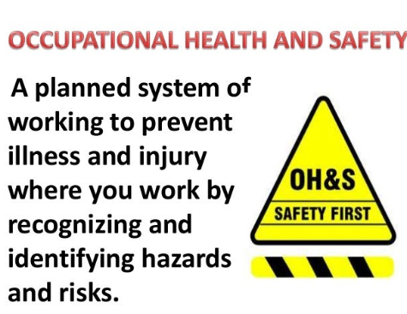
Project Worker CoC (cont.)
Occupational Health and Safety
Maintain a safe working environment by:
    Ensuring that workplaces, machinery, equipment, and processes are safe.
    Wearing personal protective equipment when required at project sites.
    Using appropriate protective measures relating to chemical, physical, and biological substances and agents.
    Following applicable emergency operating procedures.
    Reporting work situations that are not safe or healthy.
    Removing myself from a work situation where there is imminent and serious danger to my life or health.

Slide 34
Project Worker CoC (cont.)
Raising Concerns
If any person observes behavior that they believe may represent a violation of this Code of Conduct, or that otherwise concerns them, they should raise the issue promptly by contacting the Project Manager of the World Bank Project under which the works are undertaken (or delegate nominated in writing).
The Project Manager (or delegate) shall deal with the matter under the Project Grievance Mechanism and Incident Response Procedure as appropriate.
The person’s identity will be kept confidential. Anonymous complaints or allegations may also be submitted and will be given all due and appropriate consideration
There will be no retaliation against any person who raises a concern in good faith about any behavior prohibited by this Code of Conduct. Such retaliation would be a violation of this Code of Conduct.
Consequences of Violating the Code of Conduct
I understand that failure to comply with this Code of Conduct constitutes an act or acts of gross misconduct and is therefore grounds for sanctions, penalties, and/or potential prosecution by the police for those who break the law of the Republic of Marshall Islands.
If I breach this Code of Conduct, my employer will take disciplinary action which could include:
Informal or formal warning.
Additional training.
Loss of up to a salary for a period of time.
Suspension of employment (without payment of salary), for a period of time.
Termination of employment.
Report to the police or other relevant authorities.

Slide 35

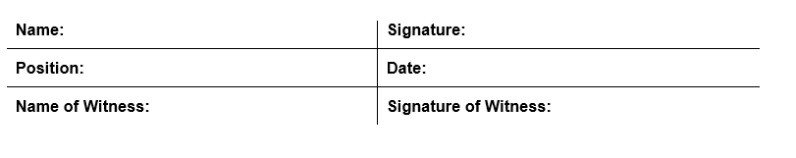
Project Worker CoC (cont.)
Acknowledgement and Agreement
I hereby acknowledge that I have received and read this Code of Conduct in a language that I understand, and that I had the opportunity to have my questions answered prior to signing this Code of Conduct, and that
I agree to abide with the standards contained therein, and that
I understand my roles and responsibilities in preventing and responding to ESHS, OHS, and SEAH.
Code of Conduct is available for download from: https://www.ciudidasafeguards.com/portfolio-documents

Slide 36

Questions? Concerns? Ideas?
KOMMOOL TATA
Link to training sign-off form: https://docs.google.com/forms/d/e/1FAIpQLSe2CcYjtQZ0eJAAhHL9wktlkvFE4StyZMbc1Z-jVMeip5MYsw/viewform?usp=sf_link

