Slide 1
Environmental and Social Safeguards
Induction Training
September 2021
Republic of the Marshall Islands
World Bank COVID-19 Project

Slide 2
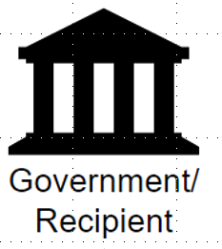
Safeguards in
World Bank Projects in RMI
World Bank provides $$ for a specific purpose as requested by RMI government
World Bank
Government
Implementing Agency
Centralized Implementation Unit (CIU)
CIU provides support
Project Implementation Unit (PIU)
PIU Project Management
PIU contracts and procures goods and services
Safeguards*
Financial
Procurement
* Managing Environmental and Social Risks (including workplace risks) associated with projects
Beneficiaries & Suppliers

Slide 3
RMI CIU Safeguards Team
Majuro: Jessica Zebedee
Safeguards Officer (DIDA)
Office Phone: (692) 625 5968
Email: jess.zebedee@gmail.com
Ebeye: Yumi Crisostomo
CIU Ebeye Program Officer
Email: mikefamilystore@gmail.com
Fiji Islands: Colleen Peacock
(Remote) Social Safeguards Specialist
Email: colleen@tautai.com
NZ: Garry Venus
(Remote) Environmental Safeguards Specialist
Email: gazza700@gmail.com
MOHHS Safeguards Contact
Majuro: Nealson TK Keju
COVID-19 Emergency Response Project Officer
Office of Health Planning, Policy, Preparedness and Epidemiology - MOHHS
Phone: (692) 625-5660 ext. 2291
Phone: (692) 455-5500
Email: nkeju@rmihealth.org

Slide 4
Safeguards Issues for COVI-19 Project
WHO Code of Ethics and Professional Conduct (COEPC)
Project requirements
Health and Safety
Stakeholder Engagement,
Labor Management Procedures
GRM and GBV pathways

Slide 5
WHO Code of Ethics and Professional Conduct
PIHOA workers engaged under the RMI COVID19 Project are to be provided with copy of WHO Code of Ethics and Professional Conduct (COEPC), April 2017
Checklist to confirm that workers are familiar with the WHO COEPC.
(refer back of this presentation)

Slide 6
Health and Safety
MOHHS Infection Prevention and Control Guide to COVID-19 will be followed to mitigate risk of contamination of workers.
Contractors engaged on laboratory upgrade works required to provide evidence of an OHS Plan addressing the following as appropriate:
operating construction equipment;
working at height;
handling heavy equipment and materials
handing hazardous substances
exposure to excessive noise and vibration

Slide 7
Stakeholder Engagement
Stakeholders are
Someone who is directly or indirectly affected by change interventions, often carried out through projects.
Includes affected parties, other interested parties and disadvantaged/vulnerable individuals or groups
A Project Stakeholder Engagement Plan has been prepared, covering:
Local engagement with communities/vulnerable groups/other parties; and for communication with /government entities.
Information provision to Gender Cluster and discussion to address issues of relevance to that group.
Disclosure of Project documentation in a culturally appropriate and accessible manner
A grievance redress/complaints mechanism for any party to raise issues about the Project

Slide 8
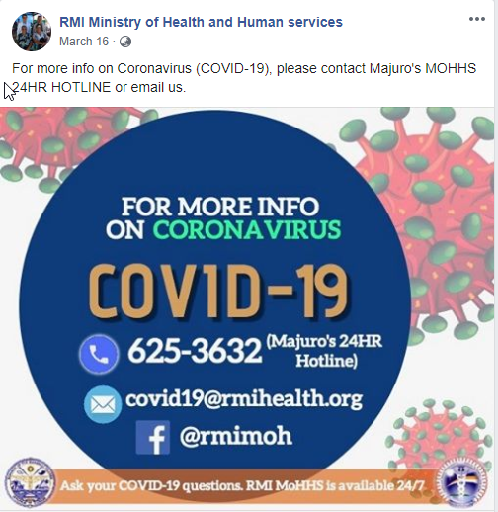
Grievance Redress Mechanism (GRM)
A Grievance is …
A report from a community or individual who believes that they are adversely affected by a World Bank-supported project.
Issues, concerns or grievances about the Project may be raised directly with WB Project staff, CIU staff or via the COVID-19 Hotline and contact system

Slide 9
Gender Based Violence (GBV)
GBV refers to any act perpetrated against a person's will that is based on their gender, gender norms and unequal power and gender relations, including physical, emotional or psychological and sexual violence, and the denial of resources or access to services. Women / girls are the majority of survivors of GBV, with men the majority of perpetrators.
WUTMI Weto in Mour: Violence Against Women and Girls Support Service (WIM), which is co-funded by the government and donor partners, ensures that survivors are accommodated in safety, have basic necessities and are provided with transport fares to enable them to attend their appointments with Micronesian Legal Services and with WIM for psychosocial support.
The Domestic Violence Prevention and Protection Act (DVPPA) provides for a temporary protection order if the judge is satisfied that a complainant, or a child in the care of a complainant, is in danger from an act of domestic violence. A judge is available 24/7 to consider protection order applications, with no filing fees charged.
For the purposes of this Project, any Grievance raised in respect of GBV would be immediately referred to WIM.

Slide 10
Labor Management Procedures (LMP)
Terms and conditions of employment | Terms and conditions to be determined by individual contracts – PIHOA contracts are OK; includes RMI COVID Hazardous Pay Differential provisions.
Age of employment | Minimum employment age 18 yrs - hazardous working conditions.
Occupational health and safety | OHS protections - MOHHS IPC protocol. Induction and follow-up training, with records of the training kept on file.
Workers’ rights to refuse unsafe work environments | Project workers able to: Report work situations they believe are not safe or healthy; Remove themselves from unsafe work situation - present an imminent and serious danger to their life or health. Not be required to return to work until necessary remedial action has been taken. Not be retaliated against for such reporting or removal.

Slide 11
Labor Management Procedures (LMP)
Workplace Grievance Mechanism | A Labor Grievance Mechanism is to be available to Project workers for raising workplace-related matters including concerns about the terms of employment, rights at work, unsafe or unhealthy work situations, among others. PIHOA contracts include a Grievance Mechanism which meets WB requirements; or. Project workers can raise workplace-related concerns or issues directly with WB Project staff, CIU staff or via the COVID-19 Hotline.

